Slide 1
Lecture-6
History of Bengal
( Medieval/ Muslim Period)

Slide 2
Medieval/ Muslim Period
Islam made its first appearance in Bengal during the 12th century when Sufi missionaries arrived. Later, occasional Muslim conquerors reinforced the process of conversion by building mosques, madrassas and Sufi Khanqah. Beginning in 1202 a military commander from the Delhi Sultanate, Bakhtiar Khilji, overran Bihar and Bengal as far east as Rangpur, Bogra and the Brahmaputra River. Although he failed to bring Bengal under his control, the expedition managed to defeat Lakshman Sen and his two sons moved to a place then called Bikrampur (present-day Munshiganj District), where their diminished dominion lasted until the late 13th century.
During the 14th century, the former kingdom became known as the Sultanate of Bengal, ruled intermittently with the Sultanate of Delhi.

Slide 3
Medieval/ Muslim Period
Ilyas Shahi dynasty
Shamsuddin Iliyas Shah founded the dynasty. It lasted from 1342–1487. The dynasty successfully repulsed attempts by Delhi to conquer them. They continued to reel in the territory of modern-day Bengal, reaching to Khulna in the south and Sylhet in the east. The sultans advanced civic institutions and became more responsive and "native" in their outlook and cut loose from Delhi. Considerable architectural projects were completed including the massive Adina Mosque and the Darasbari Mosque which still stands in Bangladesh. The Sultans of Bengal were patrons of Bengali literature and began a process in which Bengali culture and identity would flourish. The Ilyas Shahi Dynasty was interrupted by an uprising by the Hindus under Raja Ganesha. However the Ilyas Shahi dynasty was restored by Nasiruddin Mahmud Shah.

Slide 4
Medieval/ Muslim Period
Ganesha dynasty
The Ganesha dynasty began with Raja Ganesha in 1414. After Raja Ganesha seized control over Bengal he faced an imminent threat of invasion. Ganesha appealed to a powerful Muslim holy man named Qutb al Alam, to stop the threat. The saint agreed on the condition that Raja Ganesha's son Jadu would convert to Islam and rule in his place. Raja Ganesha agreed and Jadu started ruling Bengal as Jalaluddin Muhammad Shah in 1415 CE. Qutb al Alam died in 1416 CE and Raja Ganesha was emboldened to depose his son and accede to the throne himself as Danujamarddana Deva. Jalaluddin was reconverted to Hinduism by the Golden Cow ritual. After the death of his father he once again converted to Islam and started ruling his second phase. Jalaluddin's son, Shamsuddin Ahmad Shah ruled for only 3 years due to chaos and anarchy

Slide 5
Medieval/ Muslim Period
Hussain Shahi dynasty
The Hussain Shahi dynasty ruled in the period 1494–1538. Alauddin Hussain Shah, considered as the greatest of all the sultans of Bengal for bringing cultural renaissance during his reign. He extended the sultanate all the way to the port of Chittagong, which witnessed the arrival of the first Portuguese merchants. Nasiruddin Nasrat Shah gave refuge to the Afghan lords during the invasion of Babur though he remained neutral. However Nusrat Shah made a treaty with Babur and saved Bengal from a Mughal invasion. The last Sultan of the dynasty, who continued to rule from Gaur, had to contend with rising Afghan activity on his northwestern border. Eventually, the Afghans broke through and sacked the capital in 1538 where they remained for several decades until the arrival of the Mughals

Slide 6
Medieval/ Muslim Period
Mughal period
In 1534, the Afghan Sher Shah Suri, or Farid Khan – a man of incredible military and political skill – succeeded in defeating the superior forces of the Mughals under Humayun at Chausa (1539) and Kannauj (1540). Sher Shah fought back and captured both Delhi and Agra and established a kingdom stretching far into Punjab. Sher Shah's administrative skill showed in his public works, including the Grand Trunk Road connecting Sonargaon in Bengal with Peshawar in the Hindu Kush. Sher Shah's rule ended with his death in 1545, although even in those five years his reign would have a powerful influence on Indian society, politics, and economics. Shah Suri's successors lacked his administrative skill, and quarrelled over the domains of his empire. Humayun, who then ruled a rump Mughal state, saw an opportunity and in 1554 seized Lahore and Delhi.

Slide 7
Medieval/ Muslim Period
Emperor Humayun died in January 1556. Around same time, Hemu, also called Hema Chandra Vikramaditya, the then Hindu Prime Minister-cum-Chief of Army, of the Sur dynasty won Bengal in the 'battle at Chapperghatta', killing Muhammad Shah the then ruler of Bengal. This was Hemu's 20th continuous win in North India. Knowing of Humanyun's death, Hemu found a God given opportunity to win Delhi for himself and rushed to Delhi to win Agra and later on Delhi, defeated Akbar's forces at both the places, and established 'Hindu Raj' in North India on 6 Oct 1556, after 300 years of Muslim rule, leaving Bengal to his Governor Shahbaz Khan.

Slide 8
Medieval/ Muslim Period
Akbar, the greatest of the Mughal emperors, defeated the Karani rulers of Bengal in 1576. Afterwards, Bengal came once more under the control of Delhi. It became a Mughalsubah and ruled through subahdars (governors). Akbar exercised progressive rule and oversaw a period of prosperity (through trade and development) in Bengal and northern India.

Slide 9
Emergence of the Nawabs of Bengal
Bengal's trade and wealth impressed the Mughals that they called the region the "Paradise of the Nations". Administration by governors appointed by the court of the Mughal Empire court (1575–1717) gave way to four decades of semi-independence under the Nawabs of Murshidabad, who respected the nominal sovereignty of the Mughals in Delhi. The Nawabs granted permission to the French East India Company to establish a trading post at Chandernagore in 1673, and the British East India Company at Calcutta in 1690.

Slide 10
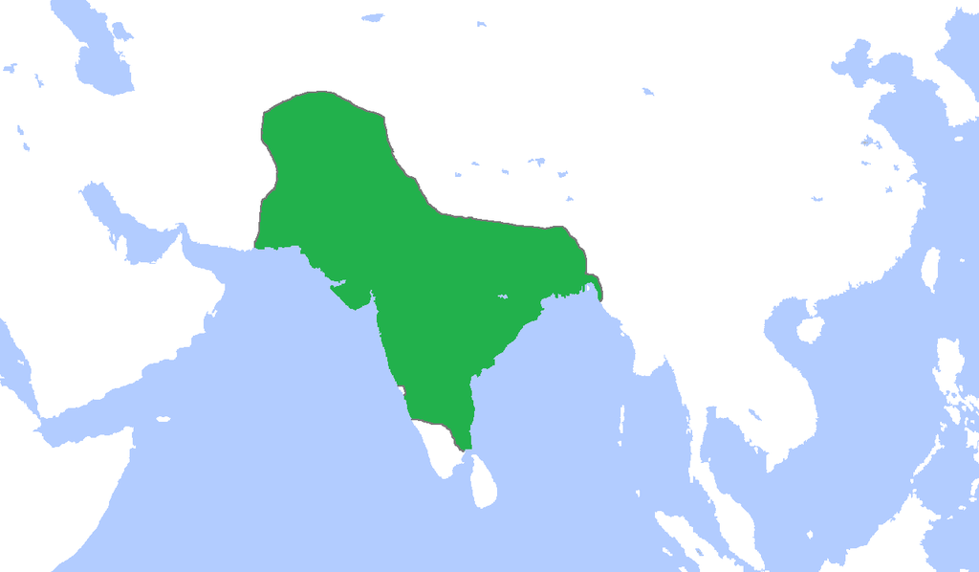
Map of Bengal under the Mughal Empire of South Asia in 1700 A.D.

Slide 11
Murshid Quli Khan arrived as the Diwan of Bengal in 1717 AD. Before his arrival, there were four Diwans. Murshid Khan was appointed the "Nawab Nizam of Bengal" and he emerged as the ruler of Bengal under the Mughals.Murshidabad remained the capital of the Nawabs of Bengal until their rule.The Nawab Siraj ud-Daulah, was betrayed in the Battle of Plassey by Mir Jaffer. He lost to the British East India Company, who took installed Mir Jaffer on the Masnad (throne), as a "puppet ruler" and established itself to a political power in Bengal.

Slide 12
Sultans
1. Ilyas Shahi dynasty (1342-1414)
2. House of Raja Ganesha (1414-1435)
3. Restored Ilyas Shahi dynasty (1435-1487)
4. Habshi rule (1487-1494)
5. Hussain Shahi dynasty (1494-1538)
6. Governors under Suri rule (1539-1554)
7. Muhammad Shah dynasty (1554-1564)
8. Karrani dynasty (1564-1576)

